Slide 1

CPRG303 – Mobile Application Development
Getting Started with Expo
Edited By:
Dr. Hamdy Ibrahim
SADT · School For Advanced Digital Technology

Slide 2
Agenda
01
Create a project
02
The folder structure
03
File-based routing
04
package.json
05
Running the app
06
Three preview targets
07
Resetting the project

Slide 3
Creating Expo Project

Slide 4
Creating Your First Expo Project
npx create-expo-app@latest MyFirstApp --template tabs
npx
Runs a tool once without installing it permanently
create-expo-app
The official tool that scaffolds a new Expo project
@latest
Use the newest version of that tool (targets SDK 57)
MyFirstApp
The folder name for your new project (your choice)

Slide 5
Project Creation Process
1
Creates a folder
A new MyFirstApp folder with all starter files
Downloads Expo, React Native & friends into node_modules
2
Installs packages
3
Sets up TypeScript
The project uses .tsx files, configured for you
4
Ready to run
Ends with "cd MyFirstApp" then "npm start"

Slide 6
Open the Project in VS Code
Using the terminal: move into the new folder and open it:
cd MyFirstApp
code .
The "." means "open the current folder". You now see the whole project on the left.
Using VSC: Open VS Code → File → Open Folder → pick MyFirstApp.
Open the built-in terminal with View → Terminal (or Ctrl+`).

Slide 7
Project Folder Structure

Slide 8
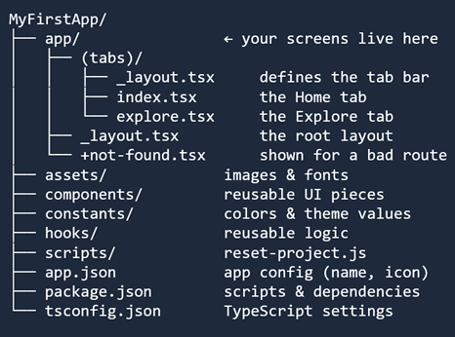
Project Folder Structure – app Folder
App: The one that matters most
Every file you put in app/ becomes a screen automatically. This is called file-based routing.
Other folders:
• components — buttons, cards, etc.
• constants — shared values
• hooks — shared behavior
• assets — pictures & fonts

Slide 9
File-Based Routing — Files Become Screens
In Expo Router, the file's location IS the screen's address. No manual navigation setup — create a file, get a screen. The (tabs) folder groups screens into the bottom tab bar.
app/(tabs)/index.tsx
Home tab
app/(tabs)/explore.tsx
Explore tab
app/(tabs)/_layout.tsx
Defines the tabs themselves
app/_layout.tsx
Wraps the whole app
Parentheses like (tabs) group screens without adding to the URL path.

Slide 10
Project Folder Structure - Supporting Folders
components/
constants/
Reusable UI pieces you build once and use everywhere — a themed button, a card.
Shared values like your color palette, so you don't repeat them in every file.
hooks/
assets/
Reusable logic — e.g. detecting light vs dark mode. You'll learn these in Week 4.
Static files: images, icons, and fonts your app displays.

Slide 11
Project Folder Structure - The 3 Config Files
Your app's identity: display name, icon, splash screen, orientation.
app.json
The project's ID card: its scripts and its list of dependencies.
package.json
TypeScript settings — usually left exactly as generated.
tsconfig.json

Slide 12
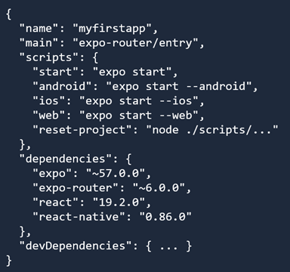
What Is package.json?
Every Node project has one.
It records the project's name, the commands you can run, and every package the project depends on. npm reads it constantly.
name
The project's name
scripts
Shortcuts you run with npm run
dependencies
Packages the app needs to run
devDependencies
Tools only needed while building

Slide 13
The scripts — Your Shortcuts
You run these with "npm run <name>" (start has a shortcut: npm start)
YOU TYPE
IT RUNS
WHAT IT DOES
Starts the dev server + shows the QR code
npm start
expo start
Starts, then opens the Android emulator
npm run android
expo start --android
Starts, then opens the iOS simulator (Mac)
npm run ios
expo start --ios
Starts, then opens the app in a browser
npm run web
expo start --web
Clears the demo code for a fresh start
npm run reset-project
node scripts/…

Slide 14
Running Apps

Slide 15
npm start — Launch the Dev Server
npm start # same as: npx expo start
This starts the Metro bundler, which:
Bundles your code and serves it to any device that connects.
Prints a QR code — scan it with Expo Go to open the app on your phone.
Shows a menu of keyboard shortcuts (next slide).
Keeps running and watches your files — save a change and the app refreshes instantly.
Leave this terminal running all time you work.
Press Ctrl + C to stop the server.

Slide 16
The Terminal Menu — Keyboard Shortcuts
After npm start, press a key to choose a target
Open in a web browser
Open on Android (emulator/device)
Open in iOS Simulator (Mac)
w
a
i
Open React Native DevTools
Toggle the dev menu
r
Reload the app
j
m
Switch Expo Go ↔ dev build
Open the code in your editor
Show all commands
s
o
?
Shift+A / Shift+I let you pick a specific emulator or simulator.

Slide 17
Three Ways to Run Same App
Pick whichever is easiest for you today
Web
Expo Go
Emulator / Sim
press w
scan QR
press a / i
Instant, in Chrome
On your real phone
A phone on screen
All 3 options run the same app and connected to the same dev server.
Any code changes are automatically reflected everywhere through Fast Refresh.

Slide 18
Resetting Expo Project

Slide 19
Reset Expo Project - npm run reset-project
It removes the starter demo screens and code, giving you a clean app folder to start building your own application.
It does two things:
Moves the demo code (the old app/ and its helpers) into a new app-example/ folder — kept for reference.
Creates a fresh app/ with just two files: index.tsx (your home screen) and _layout.tsx.
It may ask whether to delete or keep app-example. Keeping it is safe — it's just reference code you can browse or delete later. Nothing you need is lost.

Slide 20
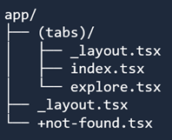

Before and After Reset
The app/ folder, simplified to a blank slate
BEFORE — app/
AFTER — app/
Plus a new app-example/ folder holding the old demo code for reference.
Now app/index.tsx is your home screen to build on.

Slide 21
Activity: Create Your First App
Follow the Day 2 handout:
1. Create a new project with create-expo-app
2. Run it and preview in web, Expo Go, and your emulator / simulator
3. Put your name in the Home tab — watch all three update
4. Reset the project, write your own text in index.tsx, and preview again
Goal: one app running in three places, edited and reset by you

